Slide 1
Chapter 17
Software Testing Strategies
Slide Set to accompany
Software Engineering: A Practitioner’s Approach, 7/e
by Roger S. Pressman
Slides copyright © 1996, 2001, 2005, 2009 by Roger S. Pressman
For non-profit educational use only
May be reproduced ONLY for student use at the university level when used in conjunction with Software Engineering: A Practitioner's Approach, 7/e. Any other reproduction or use is prohibited without the express written permission of the author.
All copyright information MUST appear if these slides are posted on a website for student use.
These slides are designed to accompany Software Engineering: A Practitioner’s Approach, 7/e (McGraw-Hill 2009). Slides copyright 2009 by Roger Pressman.

Slide 2
Software Testing
Testing is the process of exercising a program with the specific intent of finding errors prior to delivery to the end user.
These slides are designed to accompany Software Engineering: A Practitioner’s Approach, 7/e (McGraw-Hill 2009). Slides copyright 2009 by Roger Pressman.

Slide 3

What Testing Shows
errors
requirements conformance
performance
an indication
of quality
These slides are designed to accompany Software Engineering: A Practitioner’s Approach, 7/e (McGraw-Hill 2009). Slides copyright 2009 by Roger Pressman.

Slide 4
Strategic Approach
conduct effective technical reviews
Testing begins at the component level and works "outward" toward the integration of the entire computer-based system.
Different testing techniques are appropriate for different software engineering approaches and at different points in time.
Testing is conducted by the developer of the software and for large projects an independent test group.
Testing and debugging are different activities, but debugging must be accommodated in any testing strategy.
These slides are designed to accompany Software Engineering: A Practitioner’s Approach, 7/e (McGraw-Hill 2009). Slides copyright 2009 by Roger Pressman.

Slide 5
V & V
Verification refers to the set of tasks that ensure that software correctly implements a specific function.
Validation refers to a different set of tasks that ensure that the software that has been built is traceable to customer requirements.
Boehm [Boe81] states this another way:
  Verification: "Are we building the product right?"
  Validation: "Are we building the right product?"
These slides are designed to accompany Software Engineering: A Practitioner’s Approach, 7/e (McGraw-Hill 2009). Slides copyright 2009 by Roger Pressman.

Slide 6
V & V
Verification and validation includes a wide array of SQA activities:
  technical reviews, quality and configuration audits, performance monitoring, simulation, feasibility study, documentation review, database review, algorithm analysis, development testing, usability testing, qualification testing, acceptance testing, and installation testing.
These slides are designed to accompany Software Engineering: A Practitioner’s Approach, 7/e (McGraw-Hill 2009). Slides copyright 2009 by Roger Pressman.

Slide 7


Who Tests the Software?
developer
independent tester
Understands the system
Must learn about the system,
but, will test "gently"
but, will attempt to break it
and, is driven by "delivery"
and, is driven by quality
These slides are designed to accompany Software Engineering: A Practitioner’s Approach, 7/e (McGraw-Hill 2009). Slides copyright 2009 by Roger Pressman.

Slide 8
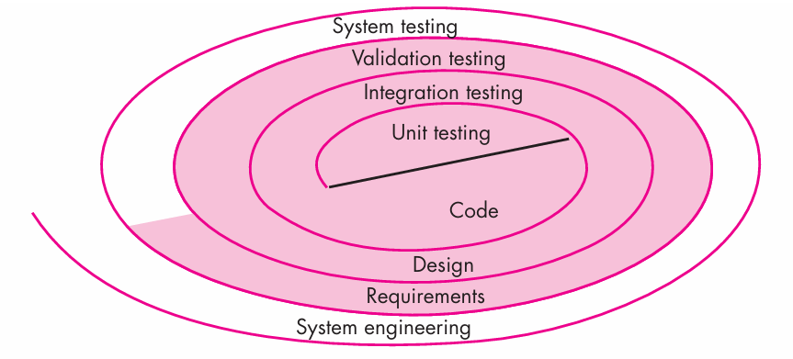
Testing Strategy
These slides are designed to accompany Software Engineering: A Practitioner’s Approach, 7/e (McGraw-Hill 2009). Slides copyright 2009 by Roger Pressman.

Slide 9
Testing Strategy
We begin by ‘testing-in-the-small’ and move toward ‘testing-in-the-large’
For conventional software
  The module (component) is our initial focus
  Integration of modules follows
For OO software
  our focus when “testing in the small” changes from an individual module (the conventional view) to an OO class that encompasses attributes and operations and implies communication and collaboration
These slides are designed to accompany Software Engineering: A Practitioner’s Approach, 7/e (McGraw-Hill 2009). Slides copyright 2009 by Roger Pressman.

Slide 10
Strategic Issues
Specify product requirements in a quantifiable manner long before testing commences.
State testing objectives explicitly.
Understand the users of the software and develop a profile for each user category.
Develop a testing plan that emphasizes “rapid cycle testing.”
Build “robust” software that is designed to test itself
Use effective technical reviews as a filter prior to testing
Conduct technical reviews to assess the test strategy and test cases themselves.
Develop a continuous improvement approach for the testing process.
These slides are designed to accompany Software Engineering: A Practitioner’s Approach, 7/e (McGraw-Hill 2009). Slides copyright 2009 by Roger Pressman.

Slide 11


Unit Testing
module
to be
tested
results
software
engineer
test cases
These slides are designed to accompany Software Engineering: A Practitioner’s Approach, 7/e (McGraw-Hill 2009). Slides copyright 2009 by Roger Pressman.

Slide 12
Unit Testing
module
to be
tested
interface
local data structures
boundary conditions
independent paths
error handling paths
test cases
These slides are designed to accompany Software Engineering: A Practitioner’s Approach, 7/e (McGraw-Hill 2009). Slides copyright 2009 by Roger Pressman.

Slide 13
Unit Testing
The module interface is tested to ensure that information properly flows into and out of the program unit under test.
Local data structures are examined to ensure that data stored temporarily maintains its integrity during all steps in an algorithm’s execution.
All independent paths through the control structure are exercised to ensure that all statements in a module have been executed at least once.
Boundary conditions are tested to ensure that the module operates properly at boundaries established to limit or restrict processing.
And finally, all error-handling paths are tested.
These slides are designed to accompany Software Engineering: A Practitioner’s Approach, 7/e (McGraw-Hill 2009). Slides copyright 2009 by Roger Pressman.

Slide 14
Unit Test Environment
driver
interface
local data structures
Module
boundary conditions
independent paths
error handling paths
stub
stub
test cases
RESULTS

Slide 15
Unit Test Environment
Because a component is not a stand-alone program, driver and/or stub software must often be developed for each unit test.
In most applications a driver is nothing more than a “main program” that accepts test case data, passes such data to the component (to be tested), and prints relevant results.
Stubs serve to replace modules that are subordinate (invoked by) the component to be tested. A stub or “dummy subprogram” uses the subordinate module’s interface, may do minimal data manipulation, prints verification of entry, and returns control to the module undergoing testing.
Drivers and stubs represent testing “overhead.” That is, both are software that must be written (formal design is not commonly applied) but that is not delivered with the final software product.
These slides are designed to accompany Software Engineering: A Practitioner’s Approach, 7/e (McGraw-Hill 2009). Slides copyright 2009 by Roger Pressman.

Slide 16

Integration Testing Strategies
Options:
  • the “big bang” approach
  • an incremental construction strategy
These slides are designed to accompany Software Engineering: A Practitioner’s Approach, 7/e (McGraw-Hill 2009). Slides copyright 2009 by Roger Pressman.

Slide 17
Top Down Integration
A
top module is tested with
stubs
B
F
G
stubs are replaced one at
a time, "depth/breadth first"
C
as new modules are integrated,
some subset of tests is re-run
D
E
These slides are designed to accompany Software Engineering: A Practitioner’s Approach, 7/e (McGraw-Hill 2009). Slides copyright 2009 by Roger Pressman.

Slide 18
Bottom-Up Integration
A
B
F
G
drivers are replaced one at a
time, "depth first"
C
worker modules are grouped into
builds and integrated
D
E
cluster
These slides are designed to accompany Software Engineering: A Practitioner’s Approach, 7/e (McGraw-Hill 2009). Slides copyright 2009 by Roger Pressman.

Slide 19
Regression Testing
Regression testing is the re-execution of some subset of tests that have already been conducted to ensure that changes have not propagated unintended side effects
Whenever software is corrected, some aspect of the software configuration (the program, its documentation, or the data that support it) is changed.
Regression testing helps to ensure that changes (due to testing or for other reasons) do not introduce unintended behavior or additional errors.
Regression testing may be conducted manually, by re-executing a subset of all test cases or using automated capture/playback tools.
These slides are designed to accompany Software Engineering: A Practitioner’s Approach, 7/e (McGraw-Hill 2009). Slides copyright 2009 by Roger Pressman.

Slide 20
Object-Oriented Testing
begins by evaluating the correctness and consistency of the analysis and design models
testing strategy changes
  the concept of the ‘unit’ broadens due to encapsulation
  integration focuses on classes and their execution across a ‘thread’ or in the context of a usage scenario
  validation uses conventional black box methods
test case design draws on conventional methods, but also encompasses special features
These slides are designed to accompany Software Engineering: A Practitioner’s Approach, 7/e (McGraw-Hill 2009). Slides copyright 2009 by Roger Pressman.

Slide 21
Broadening the View of “Testing”
It can be argued that the review of OO analysis and design models is especially useful because the same semantic constructs (e.g., classes, attributes, operations, messages) appear at the analysis, design, and code level. Therefore, a problem in the definition of class attributes that is uncovered during analysis will circumvent side effects that might occur if the problem were not discovered until design or code (or even the next iteration of analysis).
These slides are designed to accompany Software Engineering: A Practitioner’s Approach, 7/e (McGraw-Hill 2009). Slides copyright 2009 by Roger Pressman.

Slide 22
Testing the CRC Model
1. Revisit the CRC model and the object-relationship model.
2. Inspect the description of each CRC index card to determine if a delegated responsibility is part of the collaborator’s definition.
3. Invert the connection to ensure that each collaborator that is asked for service is receiving requests from a reasonable source.
4. Using the inverted connections examined in step 3, determine whether other classes might be required or whether responsibilities are properly grouped among the classes.
5. Determine whether widely requested responsibilities might be combined into a single responsibility.
6. Steps 1 to 5 are applied iteratively to each class and through each evolution of the analysis model.
These slides are designed to accompany Software Engineering: A Practitioner’s Approach, 7/e (McGraw-Hill 2009). Slides copyright 2009 by Roger Pressman.

Slide 23
OO Testing Strategy
class testing is the equivalent of unit testing
  operations within the class are tested
  the state behavior of the class is examined
integration applied three different strategies
  thread-based testing—integrates the set of classes required to respond to one input or event
  use-based testing—integrates the set of classes required to respond to one use case
  cluster testing—integrates the set of classes required to demonstrate one collaboration
These slides are designed to accompany Software Engineering: A Practitioner’s Approach, 7/e (McGraw-Hill 2009). Slides copyright 2009 by Roger Pressman.

Slide 24
High Order Testing
Validation testing
  Focus is on software requirements
System testing
  Focus is on system integration
Alpha/Beta testing
  Focus is on customer usage
Recovery testing
  forces the software to fail in a variety of ways and verifies that recovery is properly performed
Security testing
  verifies that protection mechanisms built into a system will, in fact, protect it from improper penetration
Stress testing
  executes a system in a manner that demands resources in abnormal quantity, frequency, or volume
Performance Testing
  test the run-time performance of software within the context of an integrated system
These slides are designed to accompany Software Engineering: A Practitioner’s Approach, 7/e (McGraw-Hill 2009). Slides copyright 2009 by Roger Pressman.

Slide 25
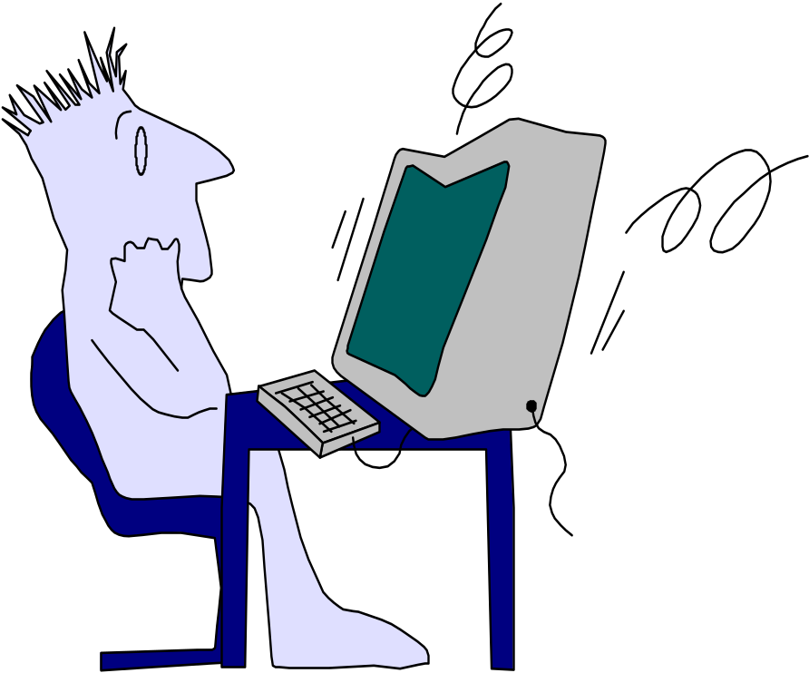
Debugging: A Diagnostic Process
These slides are designed to accompany Software Engineering: A Practitioner’s Approach, 7/e (McGraw-Hill 2009). Slides copyright 2009 by Roger Pressman.

Slide 26

The Debugging Process
These slides are designed to accompany Software Engineering: A Practitioner’s Approach, 7/e (McGraw-Hill 2009). Slides copyright 2009 by Roger Pressman.

Slide 27
The Debugging Process
Debugging is not testing but often occurs as a consequence of testing.
The debugging process begins with the execution of a test case.
Results are assessed and a lack of correspondence between expected and actual performance is encountered.
In many cases, the noncorresponding data are a symptom of an underlying cause as yet hidden.
The debugging process attempts to match symptom with cause, thereby leading to error correction.
These slides are designed to accompany Software Engineering: A Practitioner’s Approach, 7/e (McGraw-Hill 2009). Slides copyright 2009 by Roger Pressman.

Slide 28
The Debugging Process
The debugging process will usually have one of two outcomes:
(1) the cause will be found and corrected or
(2) the cause will not be found.
In the latter case, the person performing debugging may suspect a cause, design a test case to help validate that suspicion, and work toward error correction in an iterative fashion.
These slides are designed to accompany Software Engineering: A Practitioner’s Approach, 7/e (McGraw-Hill 2009). Slides copyright 2009 by Roger Pressman.

Slide 29
Why is Debugging Difficult?
The symptom and the cause may be geographically remote. That is, the symptom may appear in one part of a program, while the cause may actually be located at a site that is far removed. Highly coupled components exacerbate this situation.
The symptom may disappear (temporarily) when another error is corrected.
The symptom may actually be caused by nonerrors (e.g.,round-off inaccuracies).
The symptom may be caused by human error that is not easily traced.
These slides are designed to accompany Software Engineering: A Practitioner’s Approach, 7/e (McGraw-Hill 2009). Slides copyright 2009 by Roger Pressman.

Slide 30
Why is Debugging Difficult?
The symptom may be a result of timing problems, rather than processing problems.
It may be difficult to accurately reproduce input conditions (e.g., a real-time application in which input ordering is indeterminate).
The symptom may be intermittent. This is particularly common in embedded systems that couple hardware and software inextricably.
The symptom may be due to causes that are distributed across a number of tasks running on different processors.
These slides are designed to accompany Software Engineering: A Practitioner’s Approach, 7/e (McGraw-Hill 2009). Slides copyright 2009 by Roger Pressman.

Slide 31
Debugging Effort
time required
to diagnose the
symptom and
determine the
cause
time required
to correct the error
and conduct
regression tests
These slides are designed to accompany Software Engineering: A Practitioner’s Approach, 7/e (McGraw-Hill 2009). Slides copyright 2009 by Roger Pressman.

Slide 32
Symptoms & Causes
symptom and cause may be
geographically separated
symptom may disappear when
another problem is fixed
cause may be due to a
combination of non-errors
cause may be due to a system
or compiler error
symptom
cause may be due to
assumptions that everyone
cause
believes
symptom may be intermittent
These slides are designed to accompany Software Engineering: A Practitioner’s Approach, 7/e (McGraw-Hill 2009). Slides copyright 2009 by Roger Pressman.

Slide 33
Consequences of Bugs
infectious
damage
catastrophic
extreme
serious
disturbing
annoying
mild
Bug Type
Bug Categories:
function-related bugs,
system-related bugs, data bugs, coding bugs,
design bugs, documentation bugs, standards
violations, etc.
These slides are designed to accompany Software Engineering: A Practitioner’s Approach, 7/e (McGraw-Hill 2009). Slides copyright 2009 by Roger Pressman.

Slide 34
Debugging Techniques
brute force / testing
backtracking
Cause elimination
(induction, deduction)
These slides are designed to accompany Software Engineering: A Practitioner’s Approach, 7/e (McGraw-Hill 2009). Slides copyright 2009 by Roger Pressman.

Slide 35
Correcting the Error
Once a bug has been found, it must be corrected.
Three simple questions that you should ask before making the “correction” that removes the cause of a bug:
Is the cause of the bug reproduced in another part of the program?
What "next bug" might be introduced by the fix I'm about to make?
What could we have done to prevent this bug in the first place?
These slides are designed to accompany Software Engineering: A Practitioner’s Approach, 7/e (McGraw-Hill 2009). Slides copyright 2009 by Roger Pressman.

Slide 36
Correcting the Error
Once a bug has been found, it must be corrected.
Three simple questions that you should ask before making the “correction” that removes the cause of a bug:
Is the cause of the bug reproduced in another part of the program? In many situations, a program defect is caused by an erroneous pattern of logic that may be reproduced elsewhere.
What "next bug" might be introduced by the fix I'm about to make? Before the correction is made, the source code (or, better, the design) should be evaluated to assess coupling of logic and data structures.
What could we have done to prevent this bug in the first place? This question is the first step toward establishing a statistical software quality assurance approach. If you correct the process as well as the product, the bug will be removed from the current program and may be eliminated from all future programs.
These slides are designed to accompany Software Engineering: A Practitioner’s Approach, 7/e (McGraw-Hill 2009). Slides copyright 2009 by Roger Pressman.

Slide 37
Final Thoughts
Think -- before you act to correct
Use tools to gain additional insight
If you’re at an impasse, get help from someone else
Once you correct the bug, use regression testing to uncover any side effects
These slides are designed to accompany Software Engineering: A Practitioner’s Approach, 7/e (McGraw-Hill 2009). Slides copyright 2009 by Roger Pressman.

